Slide 1

Seahorse
Research Project
Notes:
1

Slide 2

Questions on your mind
Who is this? Why should I Iisten?
What is the problem?
What is the solution?
Is there a plan?
What are the next steps?
Notes:
‹#›

Slide 3
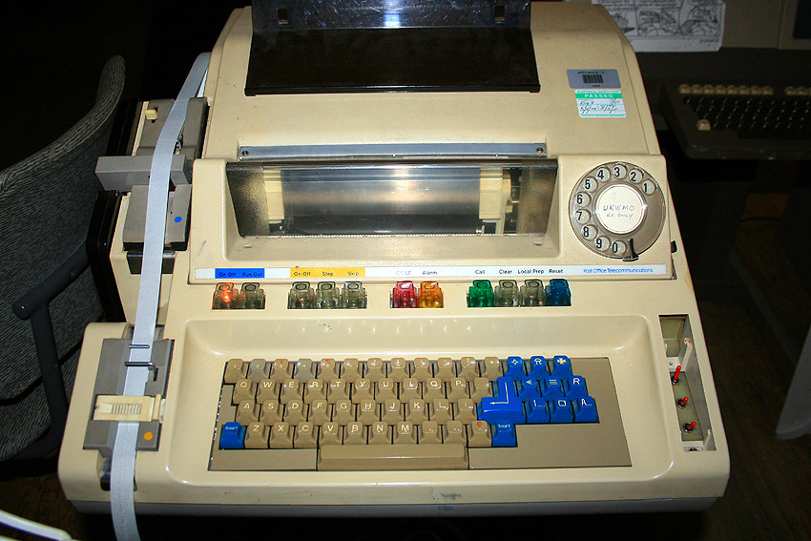
Who is this? Why should I listen?
Michael McGrath
  Chief Strategist at Micro Focus
Passion for data and information
20+ years
  Analytics
  Machine Learning
  Decision-making
  FS Transformation
Notes:
‹#›

Slide 4

What is the problem?
Notes:
5

Slide 5
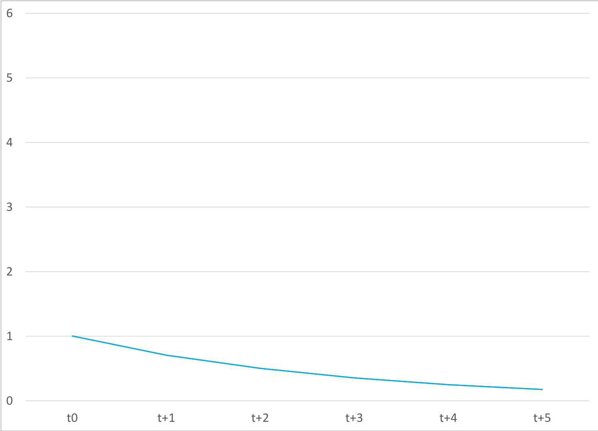
Moore’s Law
Notes:
‹#›

Slide 6
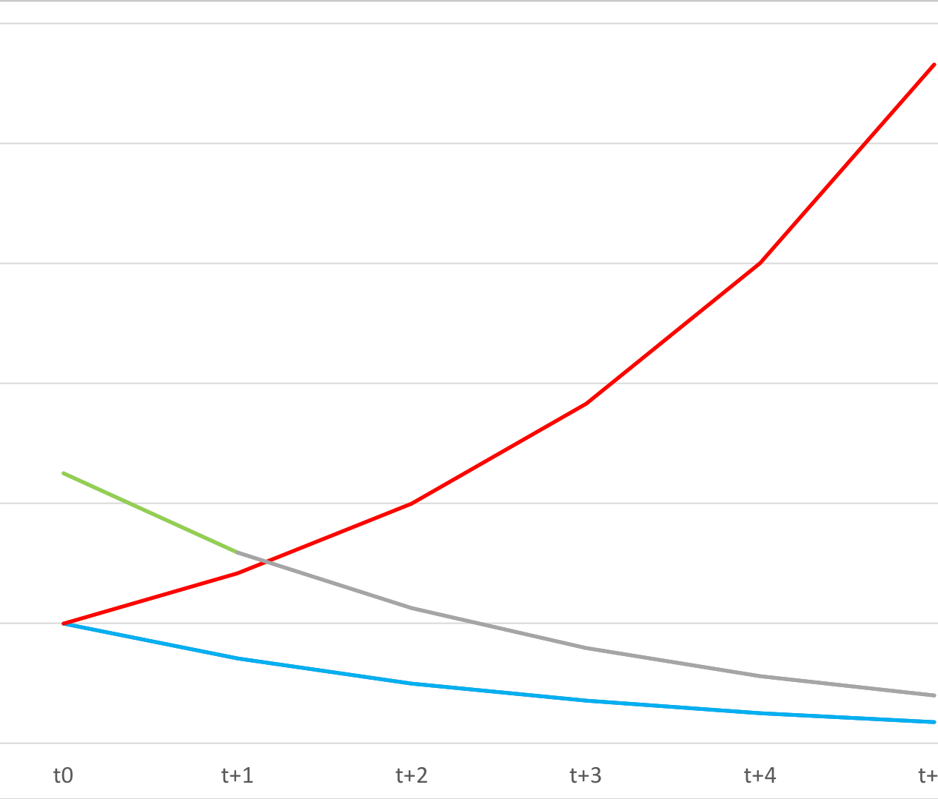
McGrath’s Paradox
Notes:
‹#›

Slide 7
Results in lot’s of issues
Value & Cost
Control
  Privacy
  Access
  Corruption of Data
Duplication
  Cost
  Security
  Error
Freedom compromised by lack of transparency and accuracy
Provenance
  Source
  Processing
  Reliability
  Robustness
Provability
  Automated decision making
Data
  Sharing
  Fidelity
  Constant transformation - Cost
Notes:
‹#›

Slide 8
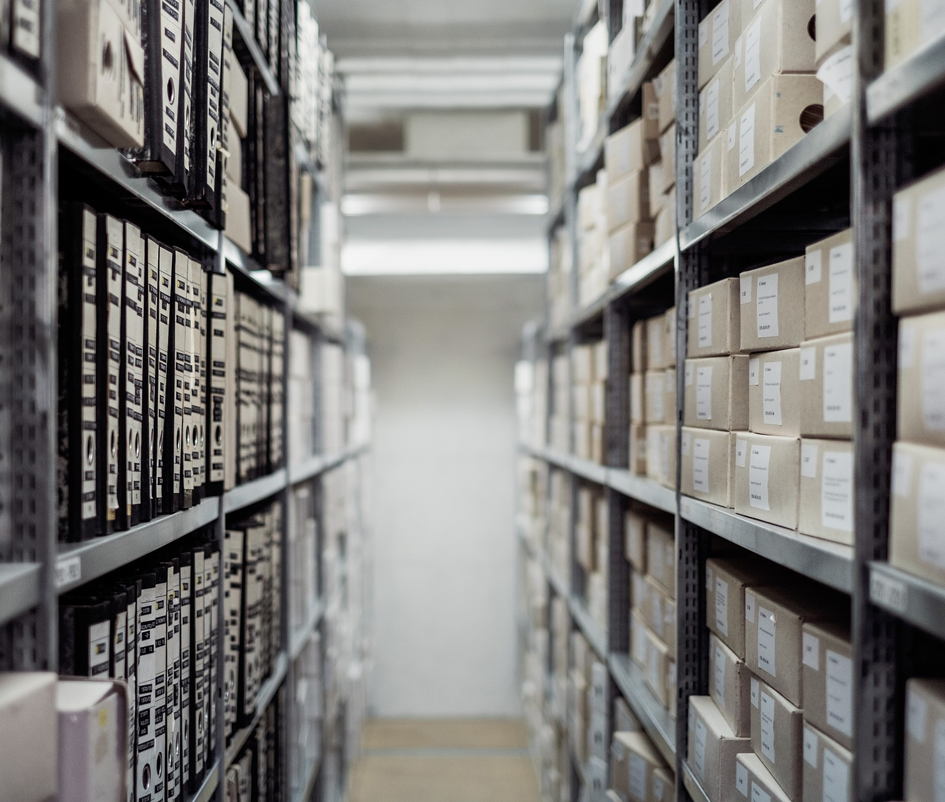
What is the solution?
Notes:
9

Slide 9
What do we need to do
Provenance & integrity practices
Data Standards & Tools
Data Lifecycle Valuation
Standardize Data Lifecycle
Notes:
‹#›

Slide 10
Standardize Data Lifecycle
Notes:
11

Slide 11
Standardize Data Lifecycle
Notes:
‹#›

Slide 12
Standardize Data Lifecycle
Notes:
13

Slide 13
Research agenda
Notes:
‹#›

Slide 14
Standardization
Standard data object definition
Standard, open source, libraries
  Transform data object to Universal Data Object (UDO)
  Transform UDO to native data object
  Standard rendering
    UI
    File
    Repository
Notes:
15

Slide 15


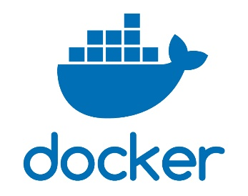
Tools
Zone of control
Data
Environment
Code
Notes:
‹#›

Slide 16
Benefits
Content providers (e.g. Bloomberg, Outlook, FaceBook) are incentivised to update the library in anticipation of message format changes and growing acceptance.
Applications consuming data will be able to do so even as message formats change they won’t directly compromise their systems and flows.
UDO compliant processing systems are able to process all UDO compatible message types in the same manner.
Software testing time is reduced; technology providers can deliver faster and at lower risk
Consumer testing time is reduced
Systems can process any UDO data type – They may not be coded to process every object feature.
Allows FSIs to maintain their existing investments in these types of technologies without having to constantly change to keep track of changing object types
Data migration will not require any transformation just extract and load
Assuming they incorporate the latest library in the build of their product. A smart provider could use JIT compilation or similar to mean their product does not require re-compilation.
Notes:
16

Slide 17
Next Steps
R&D
More rigorous research
Create “Pilot” standards consortium
Create standards consortium
Data lifecycle model
Define standard for 2-3 object types
Data cost (DLCO) and value (DV), leading to
Create open source libraries for these 2-3 object types
Data Value Analysis methodology
Notes:
17

Slide 18


Next Steps
Community
You:
LinkedIn
linkedin.com/groups/13613770
“Seahorse Data Initiative”
GitHub
EmmSquared/Seahorse
“All open and open to all”
Notes:
18

Slide 19
Questions and discussions
Reach out! e: m@lainstone.com t: @dr_data l: linkedIn.com/in/michaelmcgrath
Notes:
‹#›

